Slide 1
INTERFACING OF BUZZER WITH BEAGLEBONE BLACK
KIRANPREET KAUR GILL
GROUP #2

Slide 2
CONTENT
PROJECT OVERVIEW
REQUIREMENTS FOR INTERFACING
Hardware Requirements
Software Requirements
INTRODUCTION TO BEAGLEBONE
Pin Layout
Features
INTRODUCTION TO BUZZER
Types of Buzzer
Features
INTERFACING OF BUZZER
Schematic layout
Connections of buzzer and beaglebone black
Installing iobb library
Coding of buzzer
TERMINAL OUTPUT
REFERENCES

Slide 3
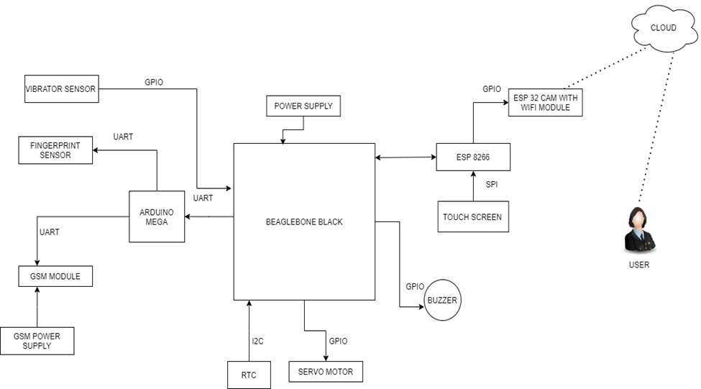
PROJECT OVERVIEW: IOT BASED BANK LOCKER SECURITY

Slide 4
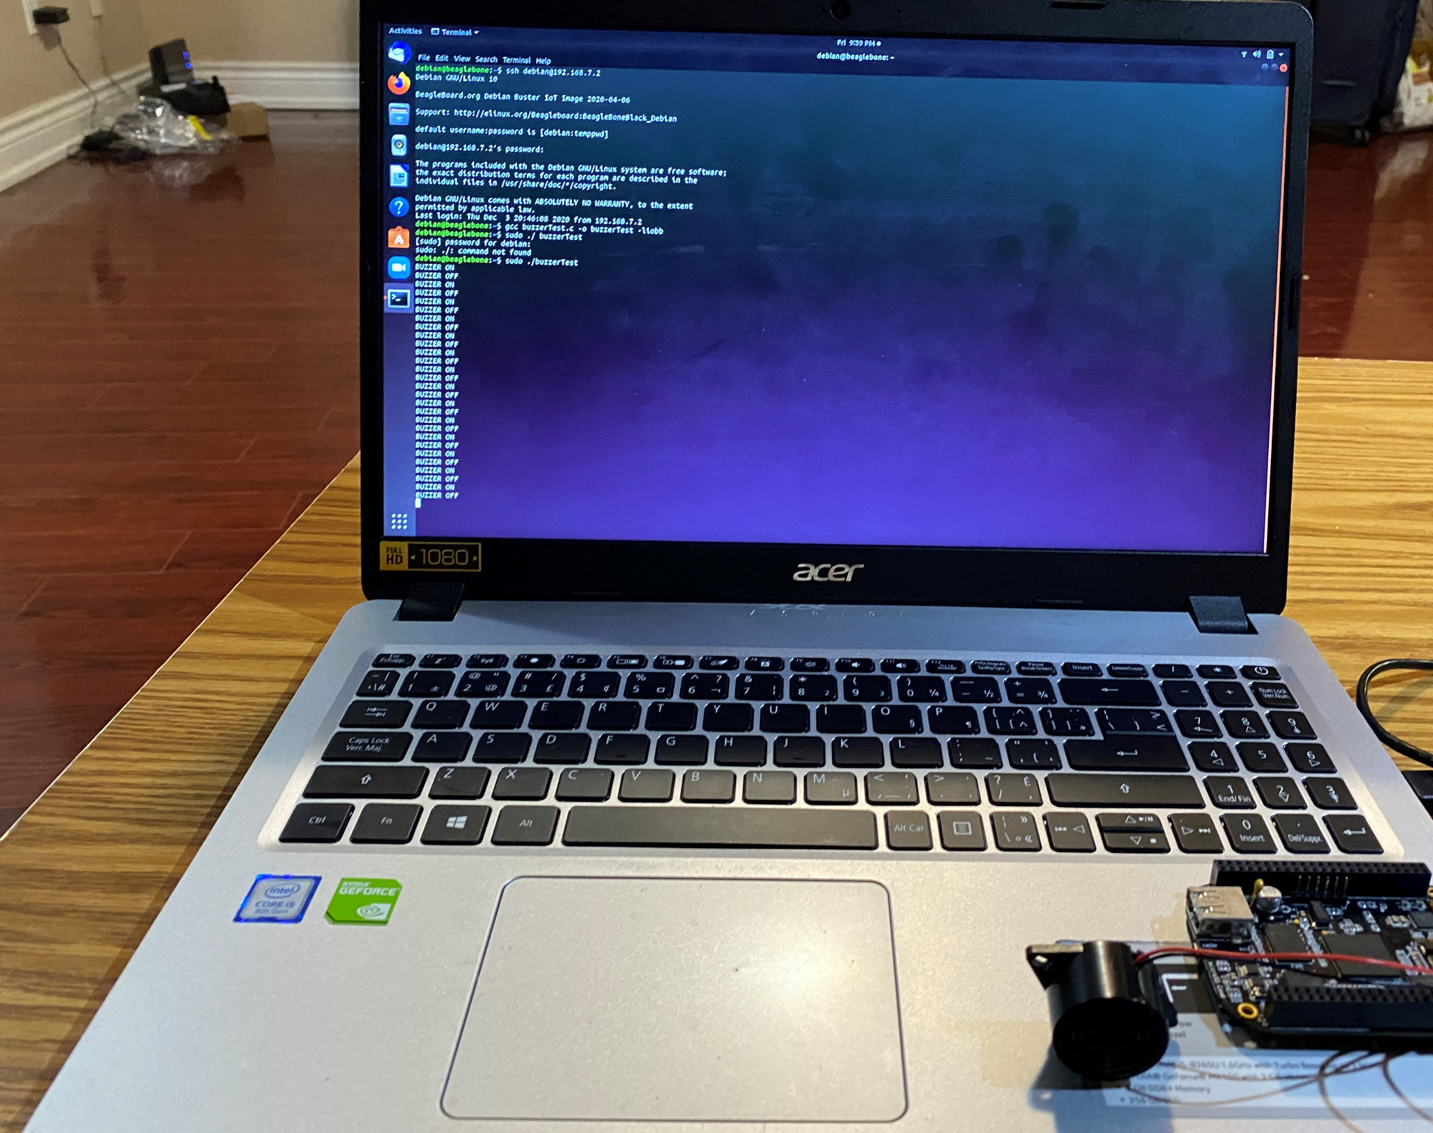
PROJECT OVERVIEW
The main objective of this project is to effectively control and manage the bank locker security using fingerprint sensor, passcode and camera.
The IOT based Bank locker security system uses an automated Safety vault with layered defense mechanism.

Slide 5
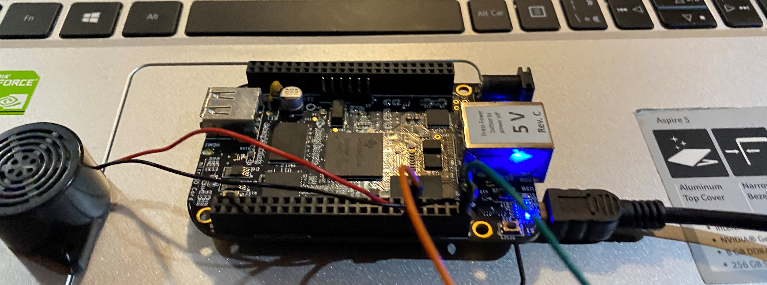
REQUIREMENTS
For the completion of this project, the first task is the interfacing of buzzer with beaglebone black.
For buzzer interfacing, there are some hardware and software requirements.

Slide 6
HARDWARE REQUIREMENTS
Beaglebone black
Buzzer
Jumper wires
USB Cable

Slide 7
SOFTWARE REQUIREMENTS
Terminal
GCC compiler
GNU Nano editor

Slide 8
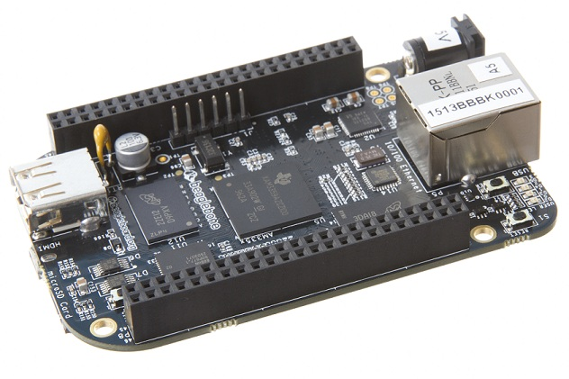
INTRODUCTION TO BEAGLEBONE BLACK
Beaglebone Black is our main microcontroller unit as all the components are connected directly
It is a low-cost, community-supported development platform.

Slide 9
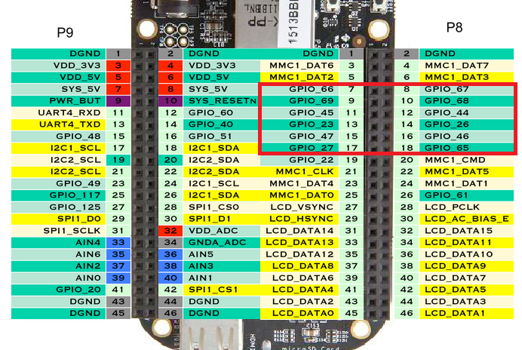
PIN LAYOUT OF BEAGLEBONE BLACK

Slide 10
FEATURES OF BEAGLEBONE BLACK
It has a range of IO including USB, SPI, I2C, UART, LCD, and GPIOs.
Connectivity
USB client for power & communications
USB host
Ethernet
HDMI
2x 46 pin headers
Software Compatibility
Debian
Android
Ubuntu
Cloud9 IDE on Node.js w/ BoneScript library

Slide 11
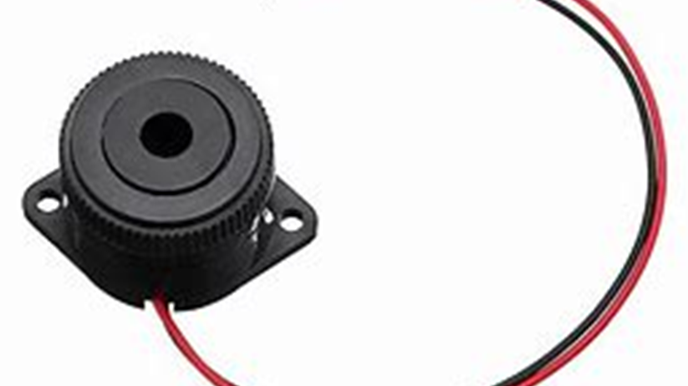
INTRODUCTION TO BUZZER
A buzzer or beeper is an audio signalling device, which may be mechanical, electromechanial, or piezoelectric (piezo for short). Typical uses of buzzers and beepers include alarm devices, timers, and confirmation of user input such as a mouse click or keystroke.

Slide 12
TYPES OF BUZZER
Buzzers come in a variety of construction, size, and specifications. Different types and sizes of buzzers are used for different applications. Based on construction, there are the following kinds of buzzers:
Piezoelectric buzzers
Magnetic buzzers
Electromagnetic buzzers
Mechanical buzzers
Electromechanical buzzers

Slide 13

FEATURES OF BUZZER
In this project, Mechanical buzzer is used with the following features:
Rated Voltage: 5V-12VDC
75dB a loud sound for alarm
Active drive inside buzzer and simplify your design, only needs to control buzzer on or off
Widely used in security and home alarm system, or other areas needs sound alarm

Slide 14
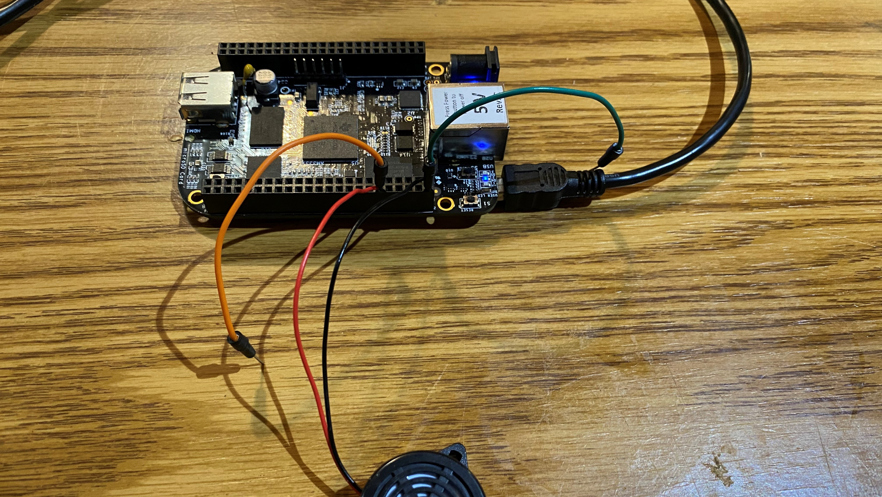
FUNCTION OF BUZZER
The buzzer will start if anything abnormal like vibration, multiple wrong passwords and fingerprint mismatched etc. are detected

Slide 15
INTERFACING OF BUZZER TO BEAGLEBONE BLACK
BUZZER | PINS OF BEAGLEBONE BLACK
RED | P8.12
BLACK | P8.2
Buzzer is directly connected to the beaglebone black with the help of GPIO pins.
Function of buzzer is to make sound when something wrong happens.

Slide 16
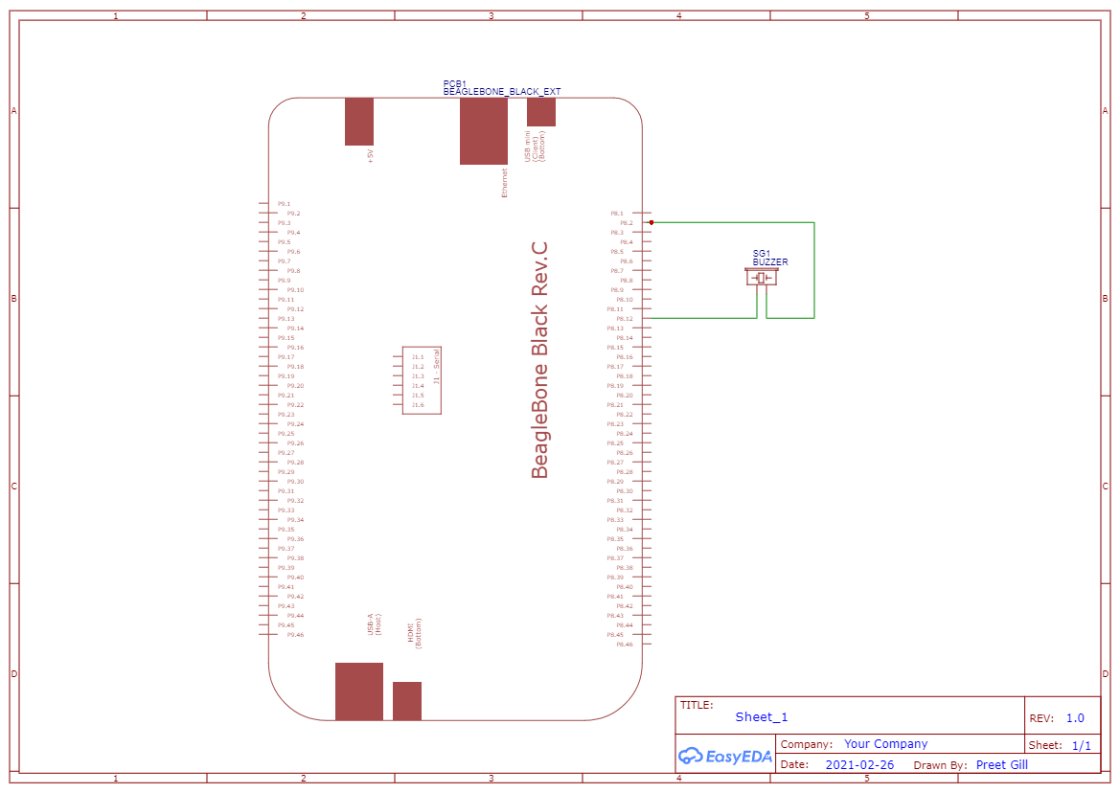
SCHEMATIC DIAGRAM

Slide 17
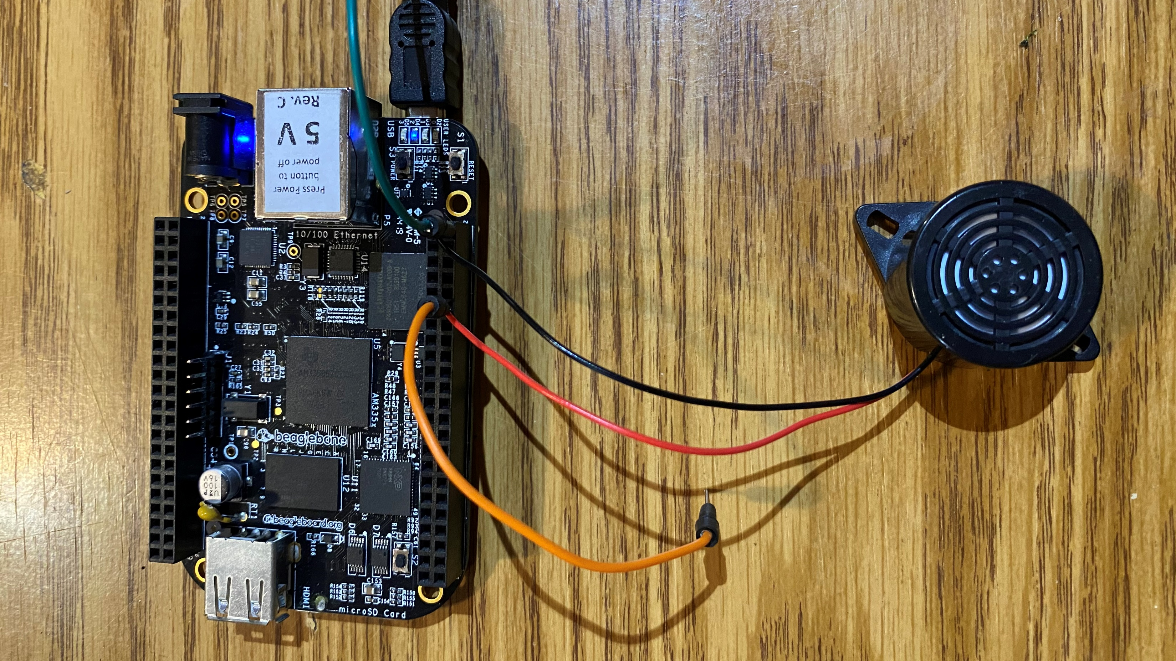
CONNECTION OF BUZZER AND BEAGLEBONE BLACK

Slide 18
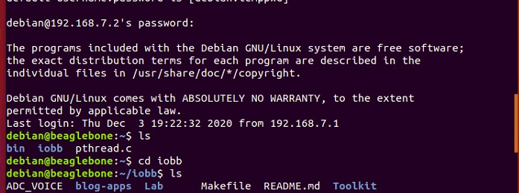
INSTALLING iobb LIBRARY
STEP1 : To install the library, initially use the command “ls” to get the list of file. Then, enter the command “cd iobb.” Here, it is used to go to the directory iobb and to open the library folder.

Slide 19
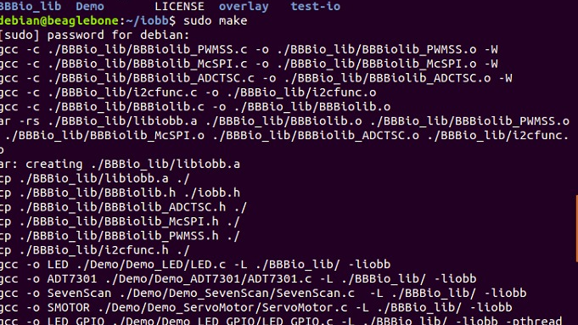
INSTALLING iobb LIBRARY
STEP 2 : “Make” command is entered to next make executable file, then it require some time to execute the command and open the file.

Slide 20
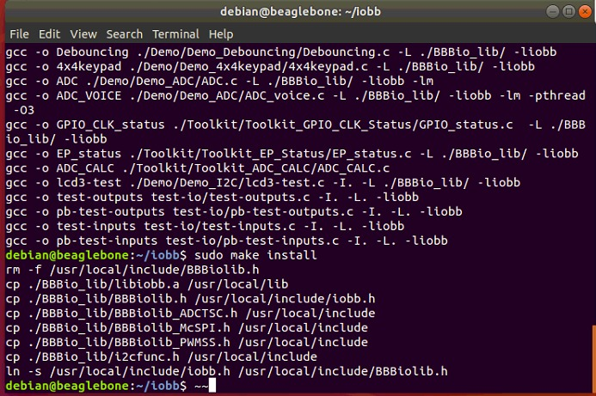
INSTALLING iobb LIBRARY
STEP 3: To install the make file “sudo make install” command is entered. Finally, the library is installed in the Beaglebone Black and is ready to use.

Slide 21
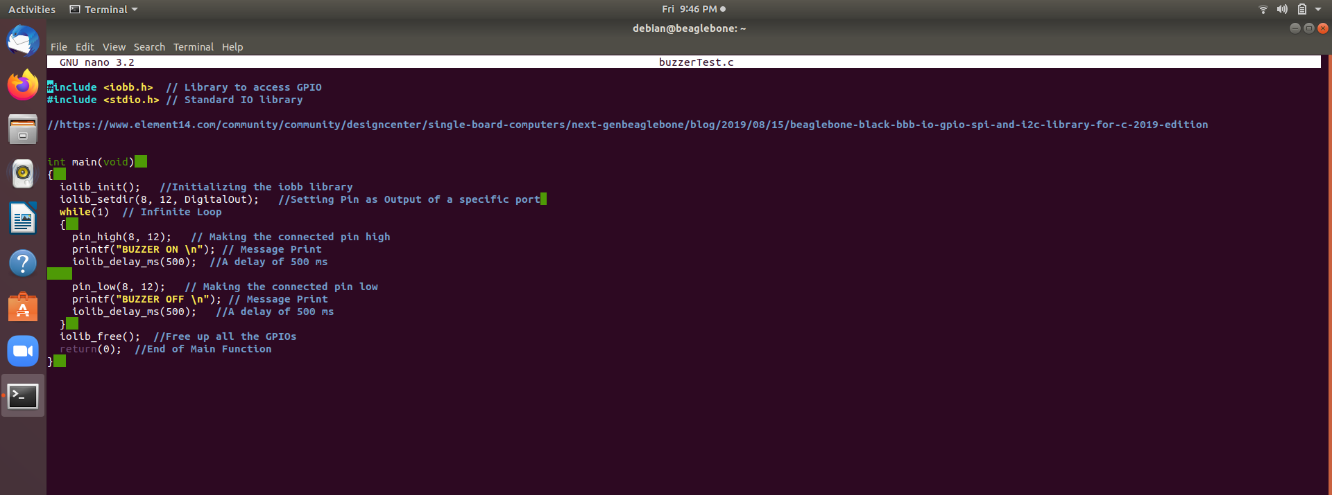
CODING OF BUZZER

Slide 22
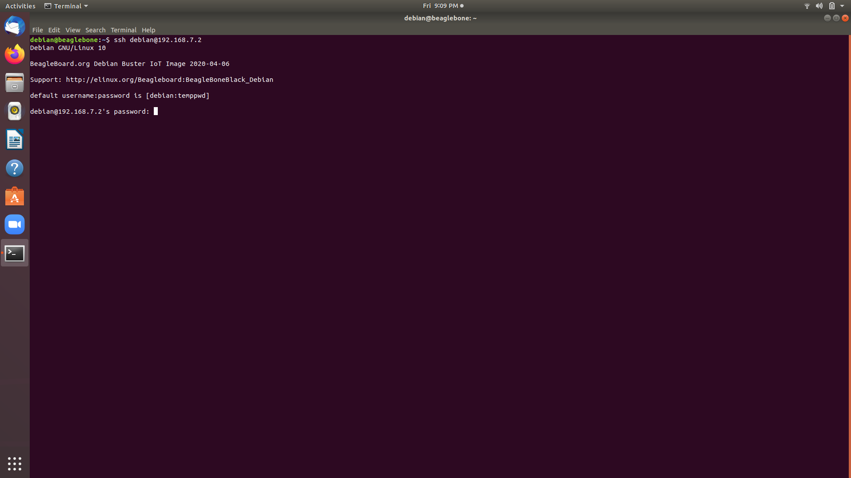
TERMINAL COMMANDS
STEP 1: Enter the command “ssh debian@192.168.7.2” here ssh command instruct the system to establish an encrypted secure connection with the host machine. Debian here represent the user_name that is being accessed on the host and then it is followed by an IP address.

Slide 23
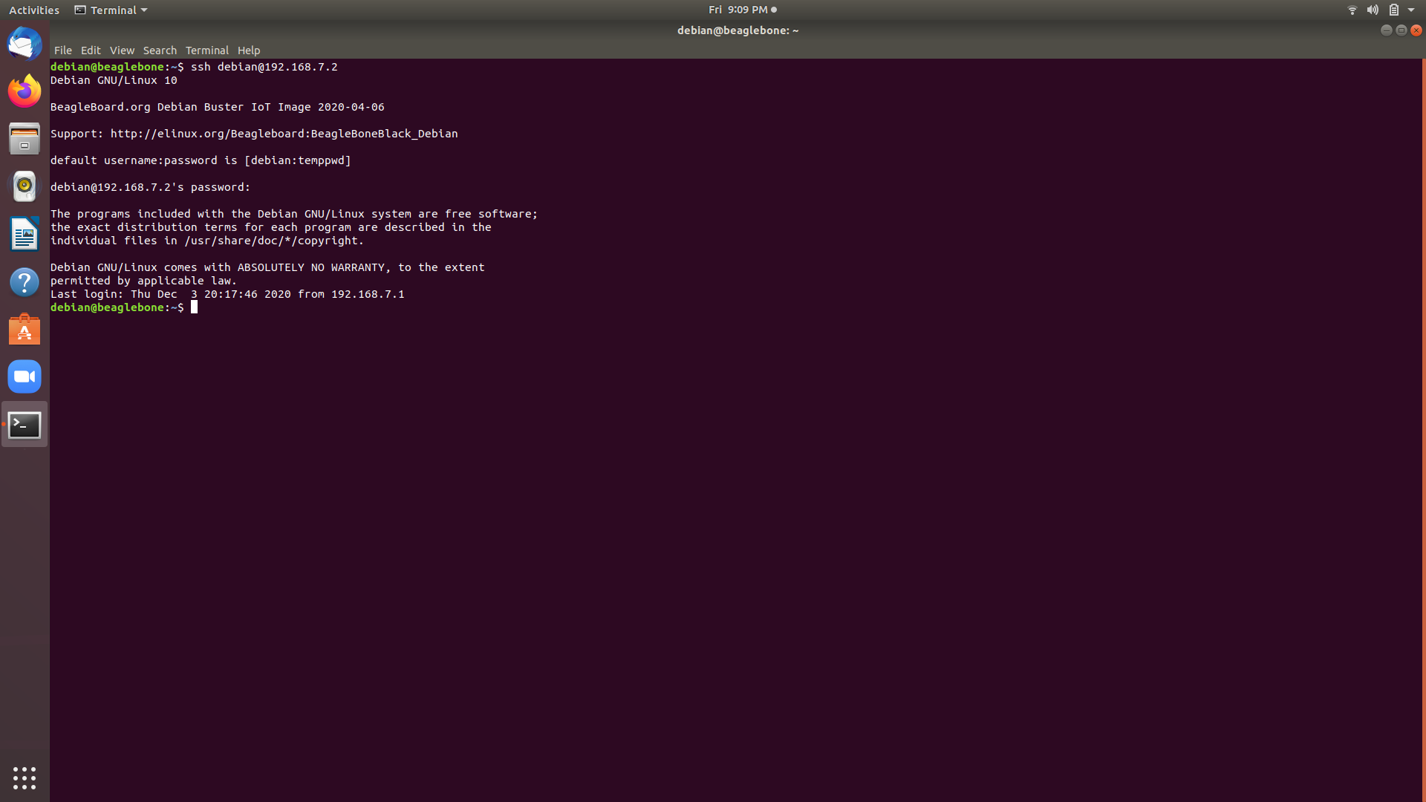
TERMINAL COMMANDS
Enter the password here.
STEP2: Before continue to next step, the password “temppwd” must be entered.

Slide 24

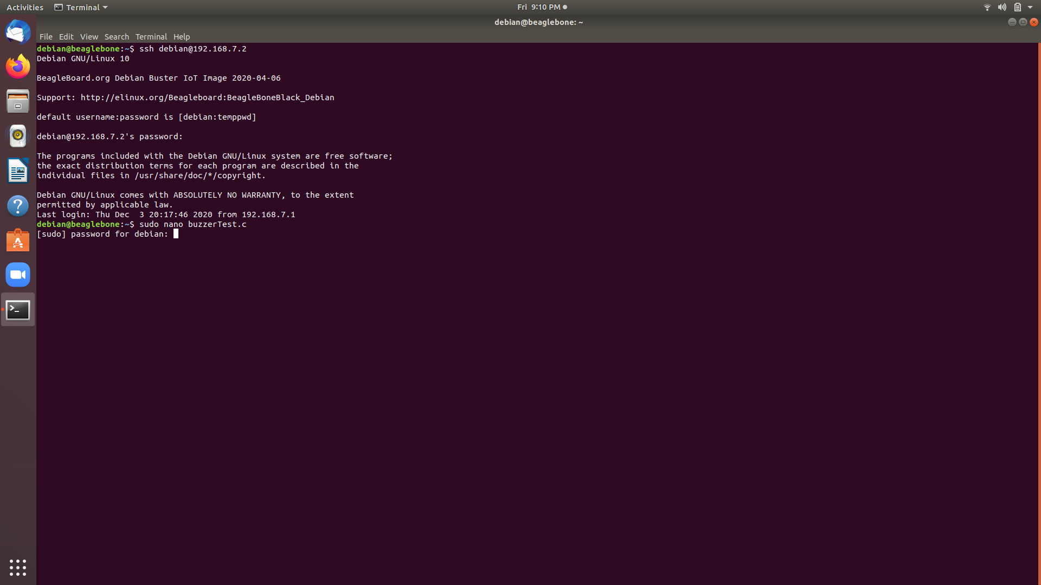
TERMINAL COMMANDS
filename
STEP 3: Enter the command “sudo nano buzzerTest.c” to open Nano text editor and to directly write, edit and navigate the code and to get immediate onscreen feedback. Here, buzzerTest.c is the file name. Then enter the same password “temppwd.”
Here CTRL+O : save the code; then press enter; CTRL+X : to exit.

Slide 25
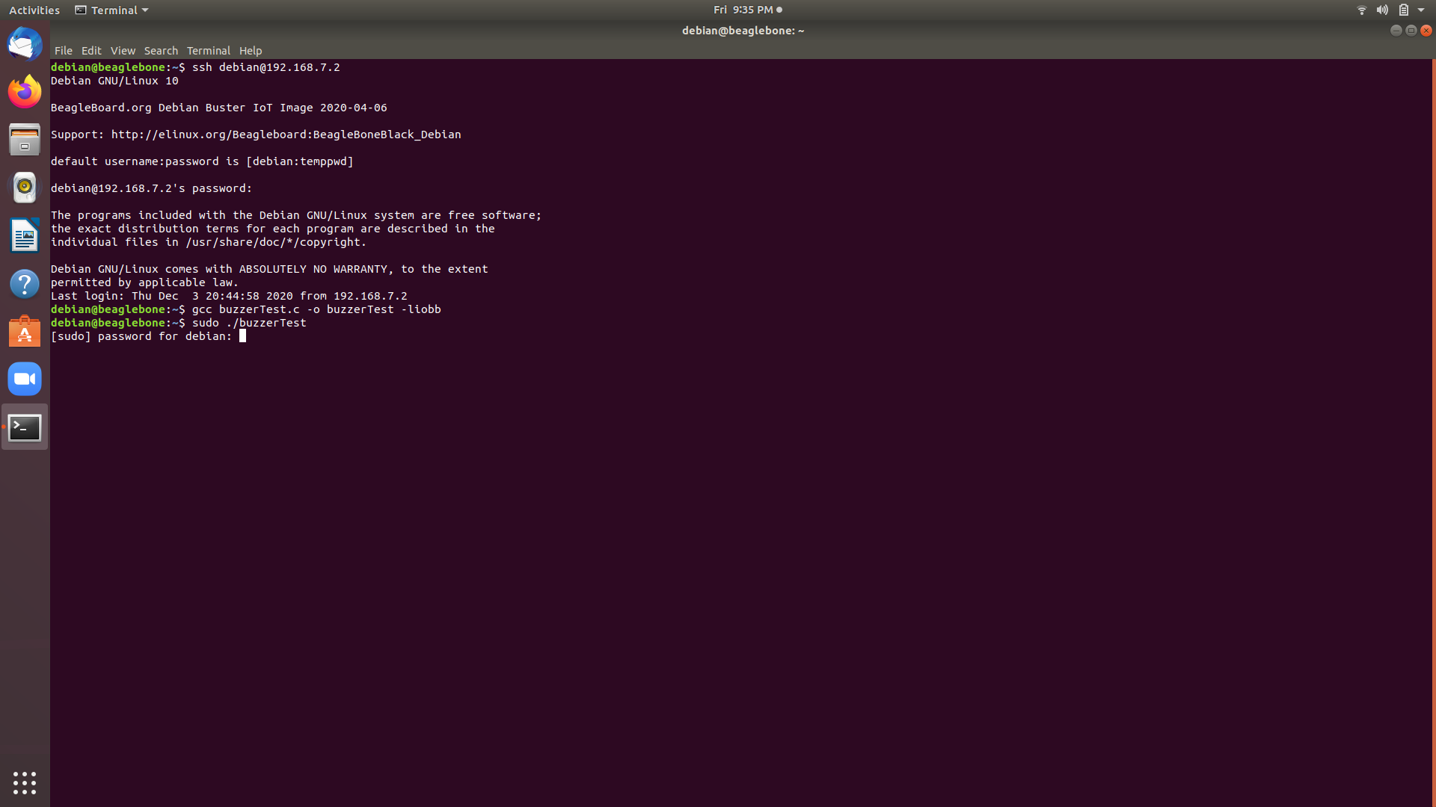
TERMINAL COMMANDS
Steps for Execution & Compilation
STEP4: To compile and execute the code, enter the command “gcc buzzerTest.c -o buzzerTest liobb.” Here, buzzerTest.c is the program_name and buzzerTest is the executable file name. Afterwards, press Enter and write the Executable_name : “sudo ./buzzerTest.”
STEP5: Again enter the password: temppwd

Slide 26
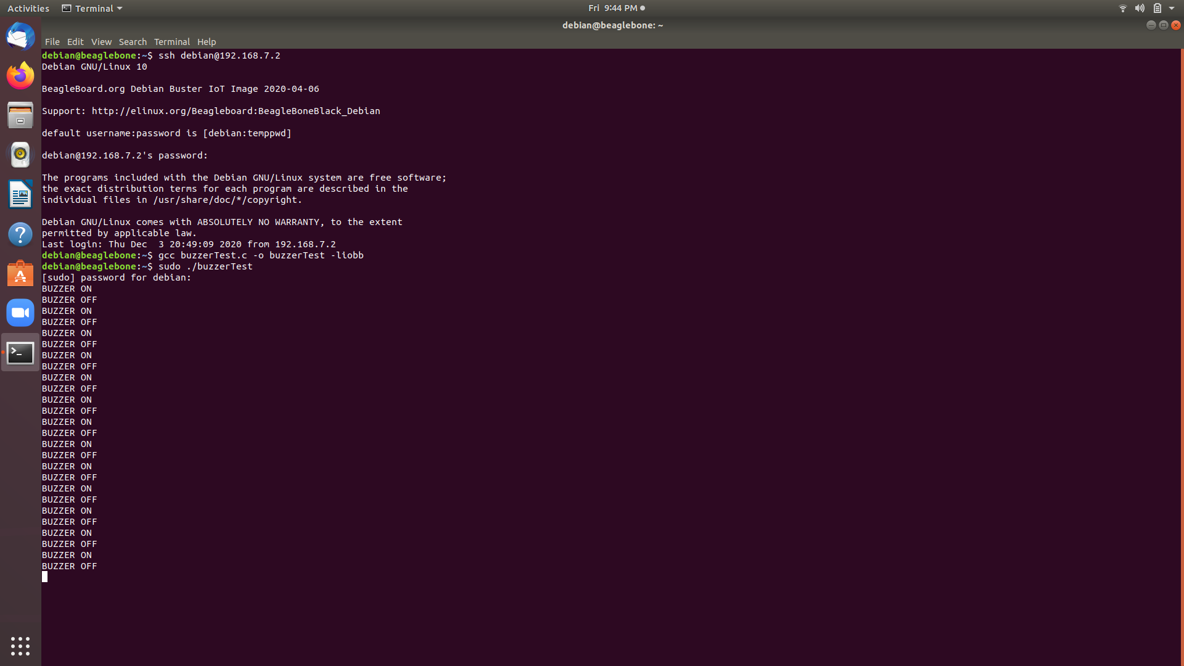
TERMINAL OUTPUT

Slide 27
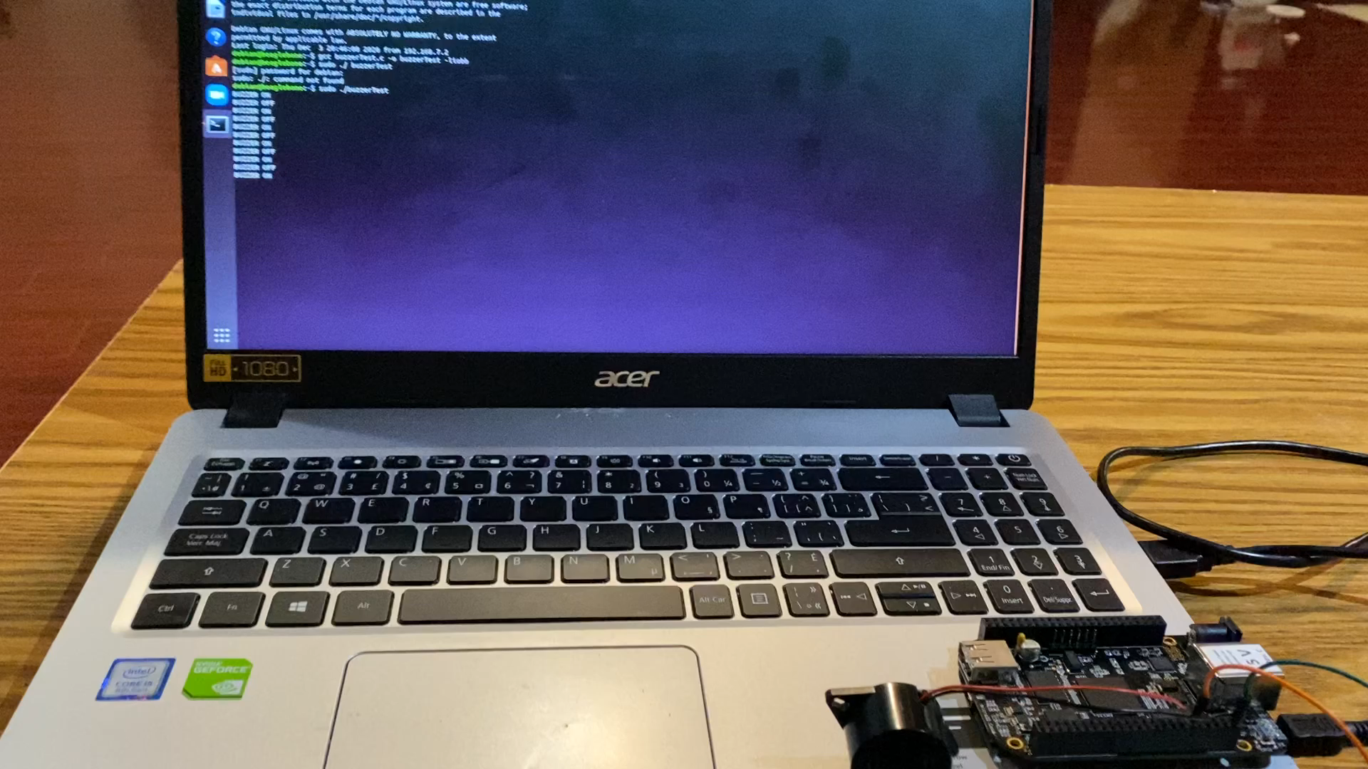
BEEPING OF BUZZER

Slide 28
REFERENCES
www.elinux.org/Beagleboard:BeagleBoneBlack
https://en.wikipedia.org/wiki/Buzzer#:~:text=History-,Electromechanical,which%20had%20a%20softer%20tone.
https://www.element14.com/community/community/designcenter/single-board-computers/next-genbeaglebone/blog/2013/10/10/bbb--beaglebone-black-io-library-for-c
https://github.com/shabaz123/iobb/blob/master/BBBio_lib/BBBiolib.c
https://www.geeksforgeeks.org/gcc-command-in-linux-with-examples/#:~:text=GCC%20stands%20for%20GNU%20Compiler,C%20and%20Objective%20C%2B%2B.

Slide 29
REFERENCES
https://linuxize.com/post/how-to-use-nano-text-editor/
https://maker.pro/linux/tutorial/basic-linux-commands-for-beginners
https://www.engineersgarage.com/tech-articles/buzzers-types-transducer-indicator-piezo-magnetic/
https://easyeda.com/editor#id=7cda8be44cda42db86c29f6dba7824a9
UHPPOTE Mechanical Buzzer Sounder 12VDC Continuous Beep with Leads 75dB for Access Control and Buzz-in System (Pack of 5) (qprographx.com)

Slide 30

THANK YOU

